Slide 1
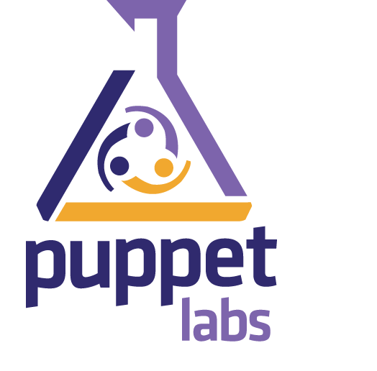
Puppet
Infrastructure & Deployment
Ganesh Ramasubramanian
16-Dec-2016
Nokia Internal Use
Notes:
Hypermedia as the Engine of Application State

Slide 2
Agenda
Introduction
Deployment Automation Framework (DAF)
Key Resources
Using DAF libraries to build platform
Unit and Beaker Acceptance Tests
Future of Analytics & Applications

Slide 3
Introduction
Puppet is a platform
For delivering and operating constantly modern software – no matter where it runs
Automated Deployment
Easy to scale
Deployment on large scale:
Faster
Quality
Consistent & Repeatable
Security & Compliance
Build
Deploy
Test
Release

Slide 4
Deployment Automation Framework
(DAF)

Slide 5
Why ?
Pros
Quick Installation
Cons
Less Flexibility
More Development work
Reduce Manual Errors
Better Knowledge Persistence
Easy Upgrade
Quick Error Recovery
Easy Scaling
Problem Detection
Less knowledge distribution
Configuration data is more vulnerable !!!

Slide 6
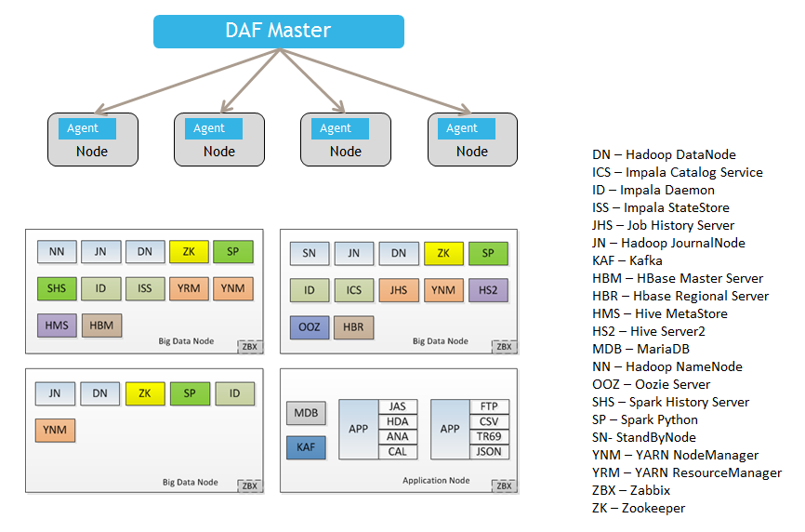
Deployment Automation Framework
DAF/Puppet Master

Slide 7
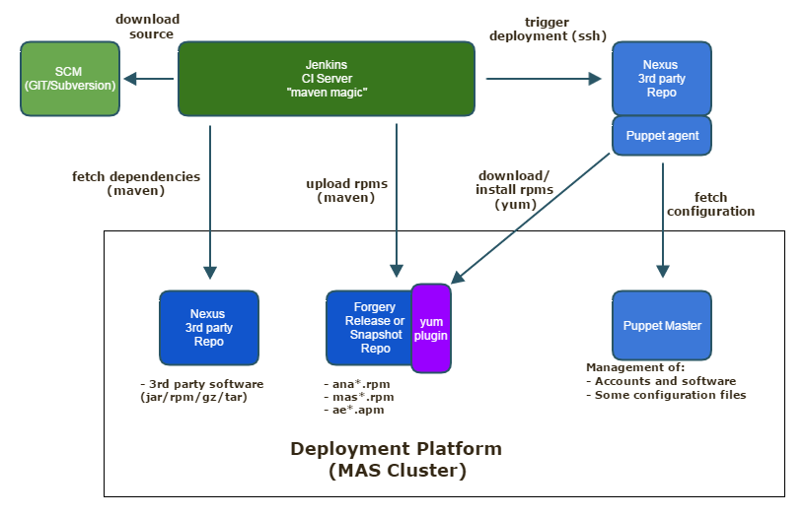
ANA Automated Delivery Process

Slide 8
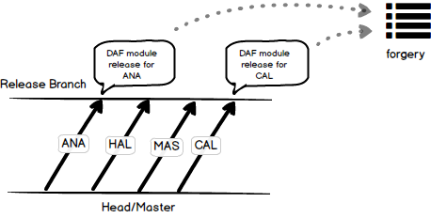
DAF Release Procedure
Continuous Delivery Procedure

Slide 9
MAS Deployment Model
MAS Deployment Model:
Core
Edge
Worker
Core & Worker
ANA uses
Core & Worker in all the 3 nodes
Node 1: Core1_Worker
Node 2: Core2_Worker
Node 3: Core3_Worker

Slide 10
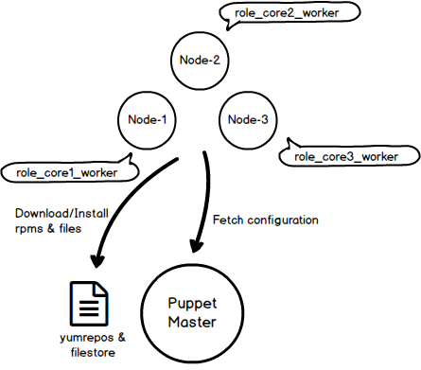
MAS Deployment Model

Slide 11
Key Resources

Slide 12
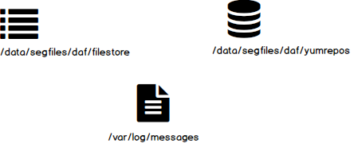
Key Resources
Key folder reference in the Master server

Slide 13
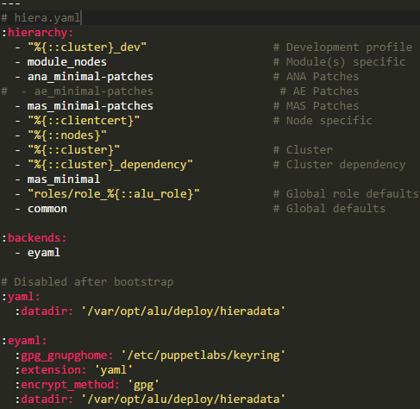
Key Resources – hiera.yaml
/etc/puppetlabs/code/hiera.yaml
Describes
- The hierarchy
- Data directory

Slide 14
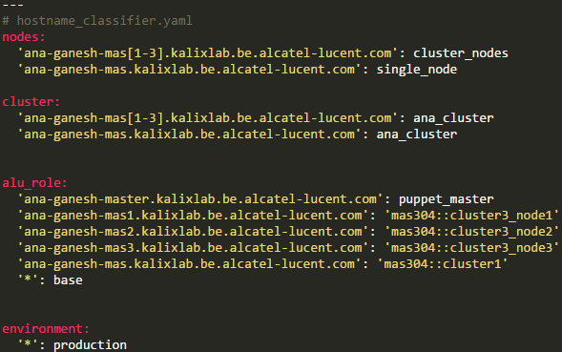
Key Resources – hostname_classifier.yaml
/var/opt/alu/deploy/hieradata/enc/hostname_classifier.yaml
Describes
- The nodes in the cluster
- The roles of each node

Slide 15
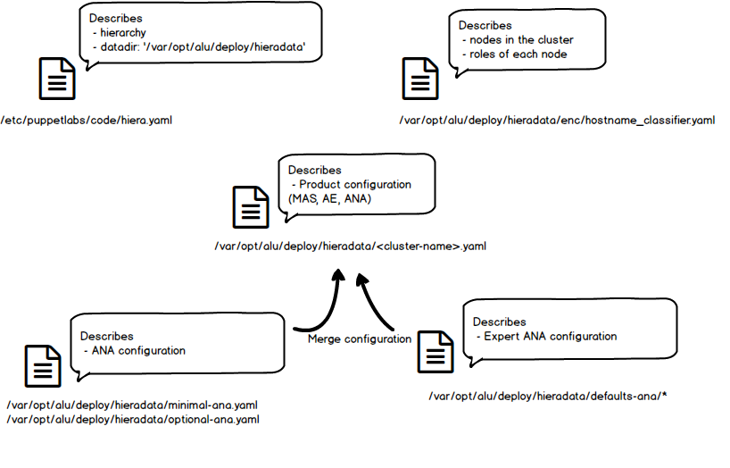
Key Resources - <cluster-name>.yaml

Slide 16
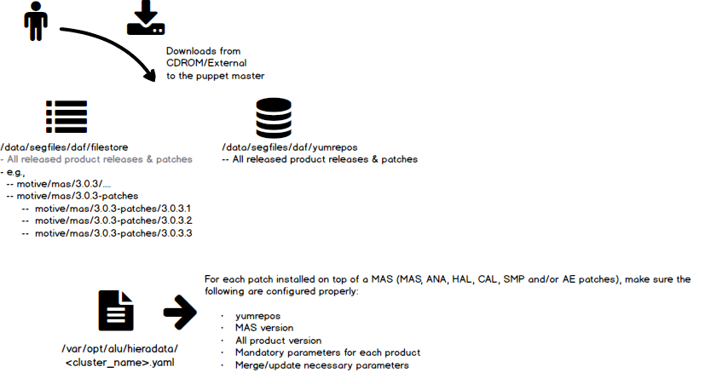
Key Resources - <cluster-name>.yaml

Slide 17
Key Resources – <cluster_name>.yaml
Configuration of
MAS
Product(s) on top of MAS such as:
ANA, HAL, CAL, SMP etc.,
Properties must be configured carefully (depending on the hierarchy defined in the hiera.yaml)
The indentation in the YAML configuration file is critical ! Follow the existing examples in the YAML configuration file.
Do not insert TAB character or white spaces and respect the indentation of the YAML configuration file, otherwise the installation will fail !

Slide 18
Using DAF libraries to build the platform

Slide 19
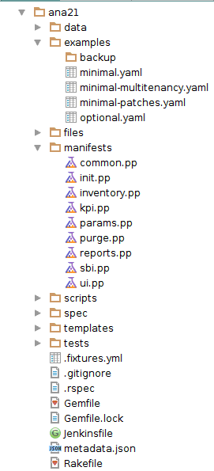
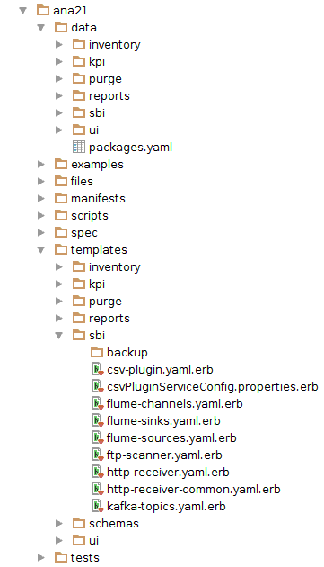
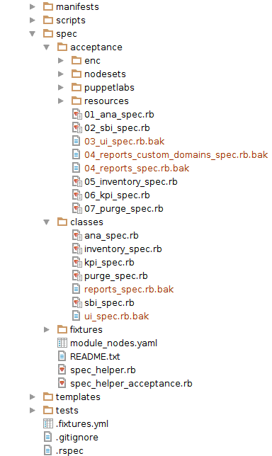
Directory Structure

Slide 20

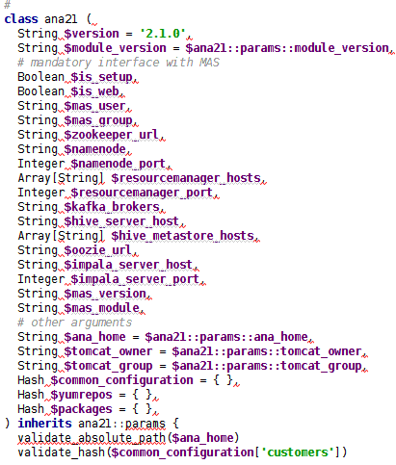
Using DAF libraries
init.pp

Slide 21
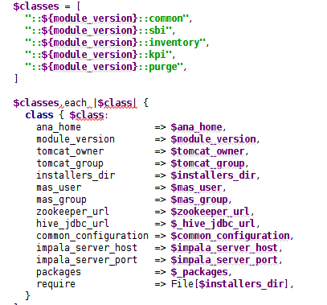
Using DAF libraries
init.pp

Slide 22
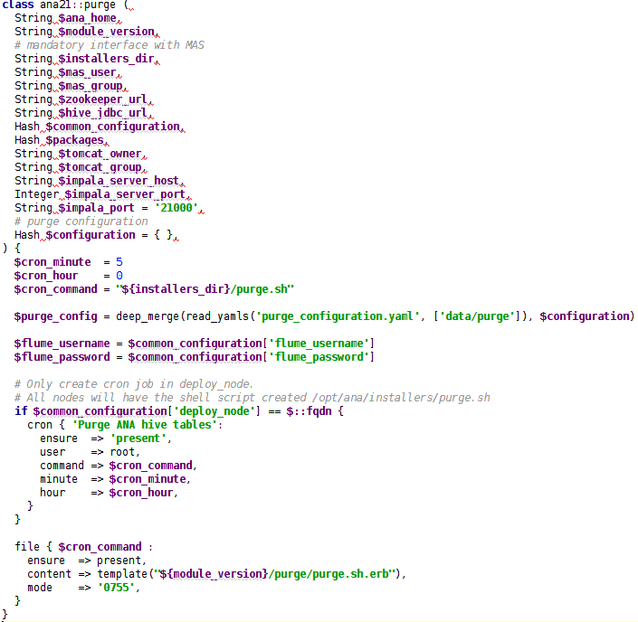
Using DAF libraries
purge.pp

Slide 23
Using DAF libraries
Commonly used puppet functions are:
package
exec
file
Complete reference:
https://docs.puppet.com/puppet/latest/function.html

Slide 24
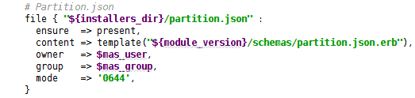
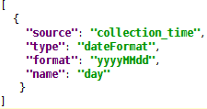
Using DAF libraries
ERB (Embedded Ruby) Templates
Puppet file
Template: <module>/schemas/partition.json.erb

Slide 25
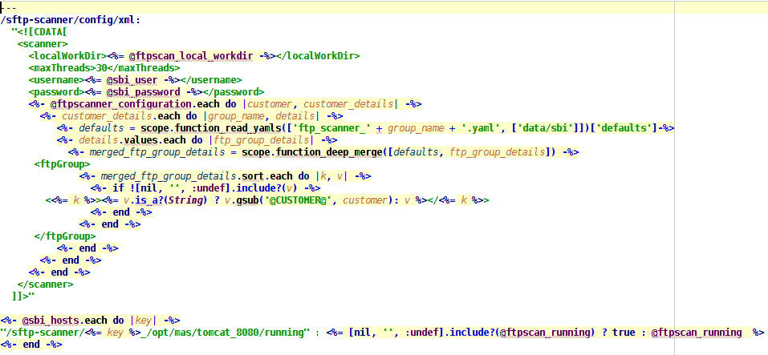
Using DAF libraries – Typical ERB Template: ftp-scanner.yaml.erb
Using in a Puppet file

Slide 26
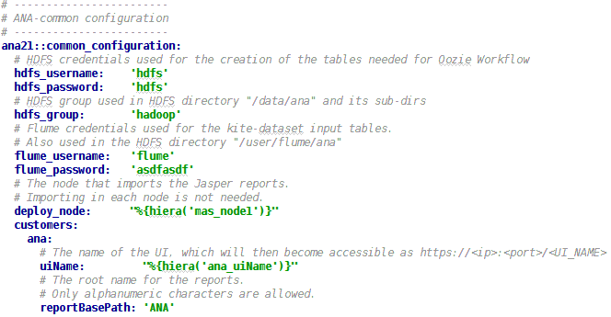
Using DAF libraries
NOTE: Do not repeat :
deploy_node ?
HDFS directories creation
Importing Jasper reports

Slide 27
Unit and Beaker Acceptance Tests

Slide 28
Unit and Beaker Acceptance Tests
Beaker Acceptance Tests
# BEAKER_set=dev BEAKER_provision=no BEAKER_destroy=no bundle exec rake beaker
Unit Tests
# bundle exec rake spec
In RUBY !!!
More information
https://confluence.motive.com/display/DAF/Beaker

Slide 29
Things to Learn
Ruby
Puppet DSL
ERB
YAML
Ctrl + V
Ctrl + C

Slide 30
Future of Application & Analytics – Environment & Others
Common Software Foundation (CSF)
Puppet => Ansible
Hypervisor : vsphere => openstack
Yum => Artifactory
Own lab: VMs => VLab: VMs
GIT in Antwerp => Corporate GIT
Fisheye => Gerrit
Jenkins in Antwerp => Corporate Jenkins

Slide 31
Future Tech Sessions
13-Jan: Spring REST and HATEOAS in action
20-Jan: Apache Camel using Spring
Notes:
HATEOAS - Hypermedia as the Engine of Application State

Slide 32
References
Motive Access Network Analytics Documentation
Deployment Automation Framework
A&A CTO DevOps Home
Access Network Analytics
Home Analytics 3.1
DAF Jenkins
Puppet Documentation
Gerrit Information
Gerrit Web UI

Slide 33


